Slide 1
Dawn 4 Dawn workshop
Copenhagen – 20th October 2016

Slide 2
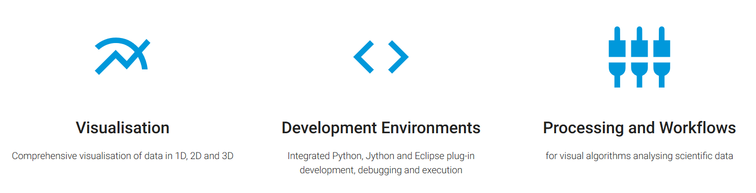
Data Analysis WorkbeNch

Slide 3
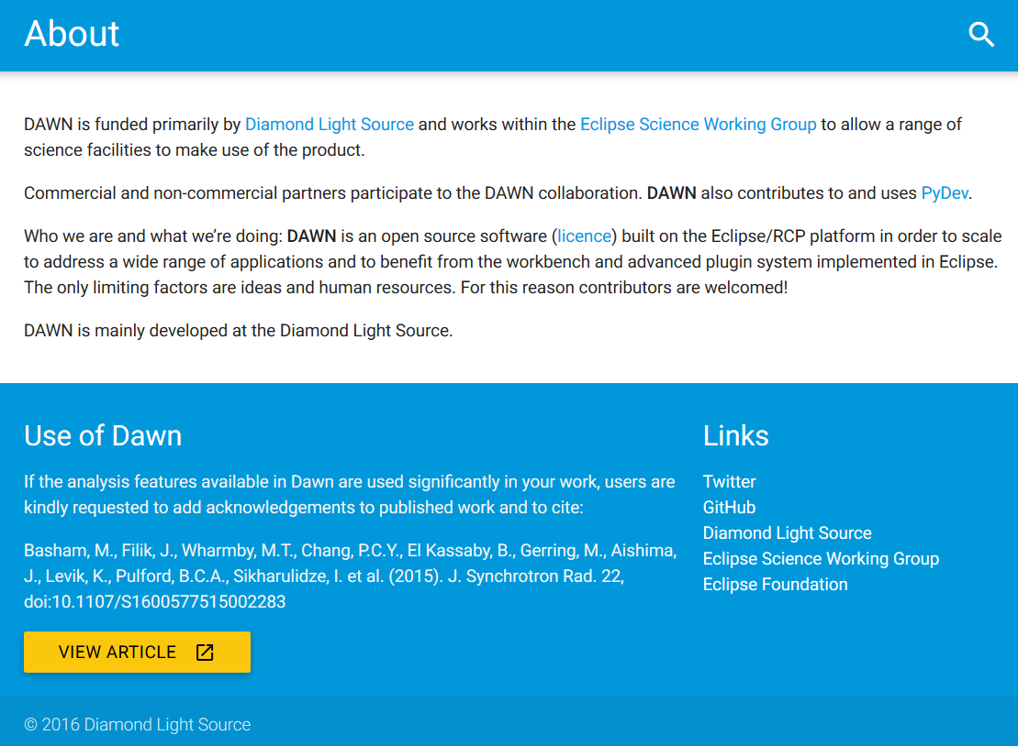

Slide 4
Create a custom Loader
Go to the Plugin-in Development perspective
Window->Perspective->Open perspective->Other->Plug-in…
Create a New DAWN Plugin-in project
File->New->DAWN plug-in project
Give it a project name, identifier, name and institute
Select “uk.ac.diamond.scisoft.analysis.io.loader” as an extension point id
Click “next” and set the file extension field to “.dde”; click “Finish”
Open the generated java class in the source folder in the new project located in your workspace to see a default loader for a custom csv file (in the resource folder of that project)

Slide 5
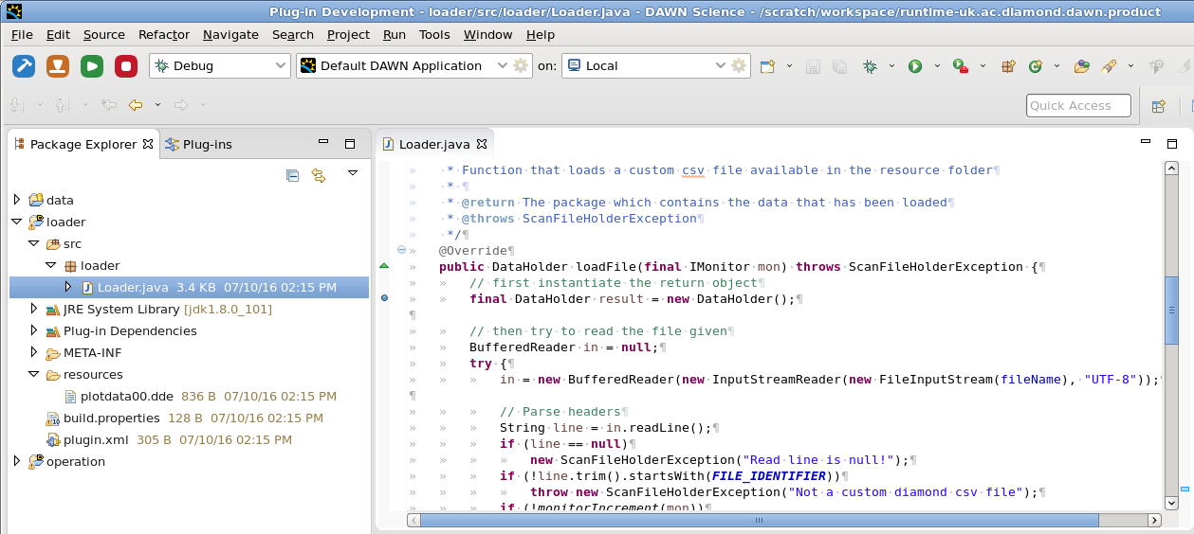


Debug through your code
Add a break point at the beginning of
“public DataHolder loadFile(final IMonitor mon)”
method
Select “Debug” next to the dev toolbar
and press the green launch button
Go to the “Processing perspective” in the new DAWN instance
Drag and drop the custom csv file in the resource folder of the DAWN development instance (“plotdata00.dde”) to the “Data Slice View” of the “processing perspective” in the new DAWN instance
Step-over the loadFile method using the Eclipse Debug toolbar in the dev DAWN instance

Slide 6
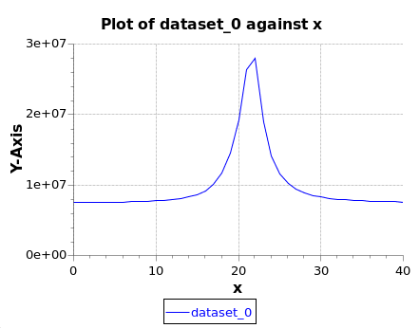
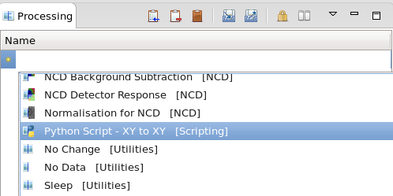
Processing
Our custom csv file is loaded through the LoaderFactory mechanism in DAWN which now has our new loader in its list of available file loaders
In the new window that pops-up, select “dataset_0[41]” as the dataset; the data plot should change; press “Finish”
In the “Processing” view, select the “Python Script – XY to XY” operation

Slide 7

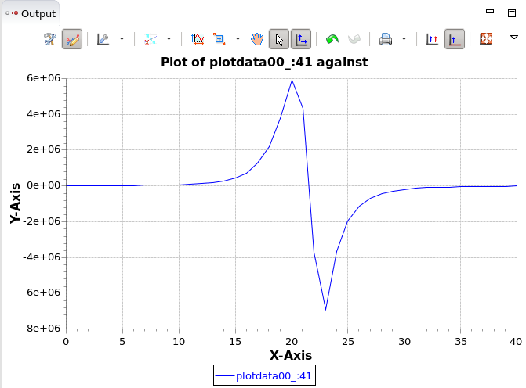
Apply a derivative with a Python script
import numpy as np
'''
Derivative python script example
'''
def run(data, xaxis, **kwargs):
result = np.gradient(data)
output = {'data': result}
output["xaxis"] = xaxis
return output
Let’s apply a derivative on the data loaded in “Processing”
Create a Pyton file to link with the operation previously added to the “Processing” view
Right-Click on a folder in a project in your workspace
Select New->File
type “derivative.py” as a file name
Add the following code to your file and save it
Link the python file to the operation
Click on the python script operation to apply the processing workflow to the data

Slide 8
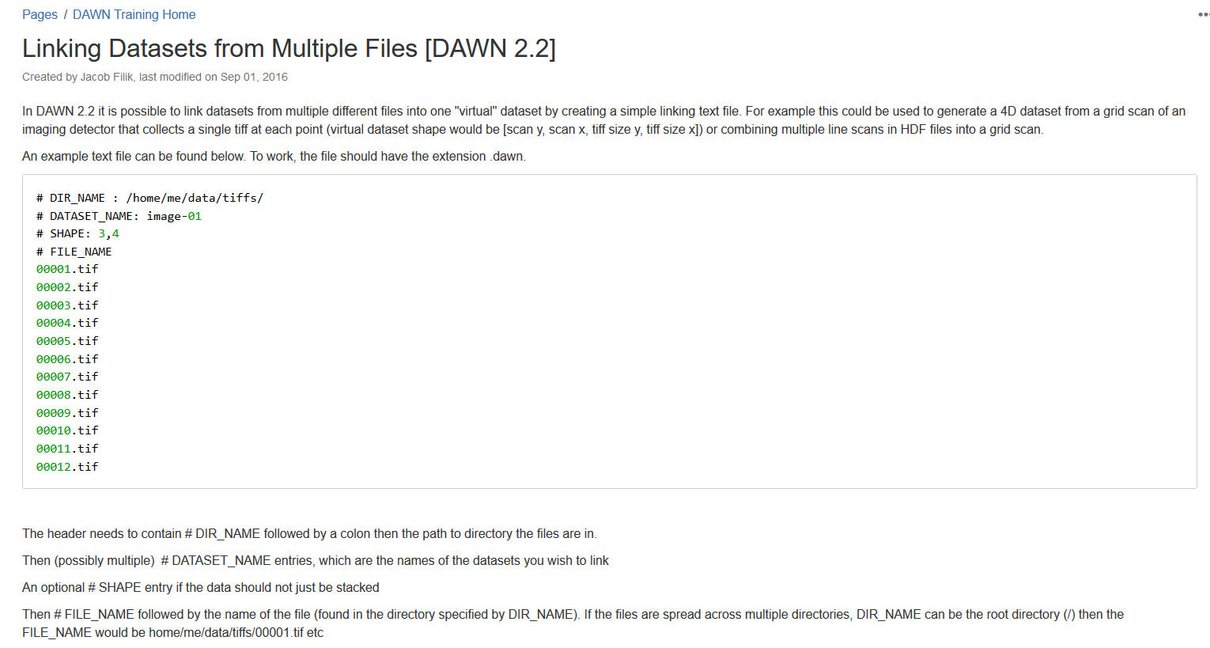
Modify the custom loader to handle a stack

Slide 9
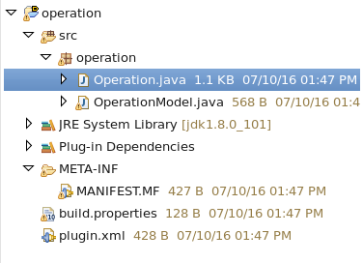
Create a custom derivative operation 1
Close the new DAWN instance and go to the DAWN dev instance
In the “Plug-in Development” perspective, select File->New->DAWN Plug-in project
In the new window, select a project name, identifier, name and institute and choose the “org.dawnsci.analysis.api.operation” id
Click “next” and give a description to your operation; press “Finish”
In the new project created, you will fin two java classes, one class defining your operation and the other the operation model
Open the operation java class

Slide 10
Create a custom derivative operation 2
In the operation java class “process” method,
Convert IDataset to Dataset using org.eclipse.january.DatasetUtils.convertToDataset()
apply the org.eclipse.january.dataset.Maths.derivative() to the input IDataset
Set the name of the derivative dataset
Return the new OperationData
Dataset converted = … ;
Dataset deriv = Maths…;
// set name of deriv
…
// return derivative
return new OperationData(…);
As a bonus you can use the model class generated to get the spread parameter the derivative method takes; this parameter can be an input in the model ui :
@OperationModelField(hint="Enter value for spread", label = "Value")
private int derivSpread = 1;

Slide 11
Solution
//In the Operation class:
@Override
protected OperationData process(IDataset input, IMonitor monitor) throws OperationException {
Dataset data = DatasetUtils.convertToDataset(input);
// retrieve the ui input from the model for the derivative spread parameter
int spread = model.getDerivSpread();
// apply derivative using Maths class in Eclipse January
Dataset indices = data.getIndices().squeeze();
Dataset deriv = Maths.derivative(indices, data, spread);
deriv.setName("Derivative Data");
copyMetadata(input, deriv);
// return derivative
return new OperationData(deriv);
}
//In the Model class:
@OperationModelField(hint="Enter value for operation", label = "Value")
private int derivSpread = 1;
public int getDerivSpread() {
return derivSpread;
}
public void setDerivSpread(int derivSpread) {
firePropertyChange("derivSpread", this.derivSpread, this.derivSpread = derivSpread);
}

Slide 12
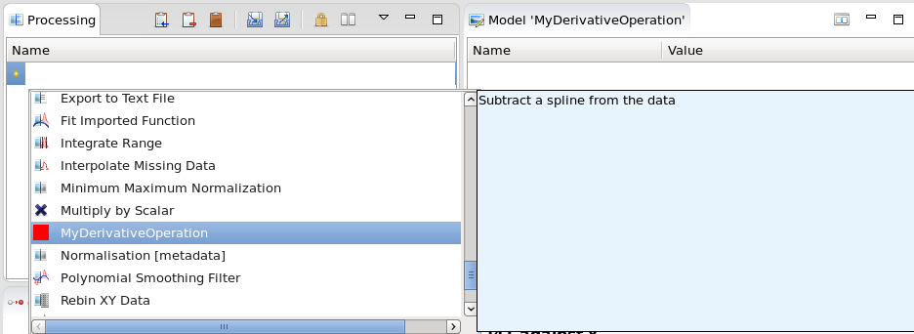
Use derivative operation created
Build your projects by typing the following keys: CTRL+B
Run the new debug instance of DAWN by pressing the launch button
Drag and drop the csv file to the data slice view
Select the custom derivative operation created
Apply the operation to the processing workflow and visualize your data in the output

